Slide 1
SOTWARE TESTING (CS-497)
Course Instructor: AMIR IMAM
Automation Testing

Slide 2
What is Test Automation?
Automation Testing means using an automation tool to execute your test case suite

Slide 3
The Mission of Test Automation
What is your test mission?
What kind of bugs are you looking for?
What concerns are you addressing?
Who is your audience?
Make automation serve your mission.
Expect your mission to change.

Slide 4
Possible Missions for Test Automation
Find important bugs fast
Measure and document product quality
Verify key features
Keep up with development
Assess software stability, concurrency, scalability…
Provide service

Slide 5
Possible Missions for Test Automation
Efficiency
Reduce testing costs
Reduce time spent in the testing phase
Automate regression tests
Improve test coverage
Reduce impact on the bottom line
Service
Tighten build cycles
Enable “refactoring” and other risky practices
Prevent destabilization
Play to computer and human strengths
Increase management confidence in the product

Slide 6
Possible Missions for Test Automation
Extending our reach
API based testing
Use hooks and scaffolding
Component testing
Model based tests
Data driven tests
Internal monitoring and control
Multiply our resources
Platform testing
Configuration testing
Model based tests
Data driven tests

Slide 7
Testing Analogy: Clearing Weeds
weeds

Slide 8
Totally repeatable tests won’t clear the weeds
weeds
fixes

Slide 9
Variable Tests are Often More Effective
weeds
fixes

Slide 10
Framework-Based Architecture
Frameworks are code libraries that separate routine calls from designed tests.
modularity
reuse of components
hide design evolution of UI or tool commands
partial salvation from the custom control problem
independence of application (the test case) from user interface details (execute using keyboard? Mouse? API?)
For more on frameworks, see Linda Hayes’ book on automated testing, Tom Arnold’s book on Visual Test, and Mark Fewster & Dorothy Graham’s excellent new book “Software Test Automation.”
I will demo you my own written framework

Slide 11
Regression Strategy
Summary:
“Repeat testing after changes.”
Fundamental question or goal
Manage the risks that
a bug fix didn’t fix the bug.
an old bug comes back.
a change had a side effect.

Slide 12
Regression Strategy
Paradigmatic cases
Retesting (Show that a bug was not fixed.)
Old fix regression (Show that an old bug fix was broken.)
General functional regression (Show that a change caused a working area to break.)
Strengths
Reassuring, confidence building, regulator-friendly.
Blind spots
Anything not covered in the regression series.
Maintenance of this test set can be costly.

Slide 13
Automated Regression Testing
The most common regression automation technique:
Conceive and create a test case
Run it and inspect the output results
If the program fails, report a bug and try again later
If the program passes the test, save the resulting outputs
In future tests, run the program and compare the output to the saved results
Report an exception whenever the current output and the saved output don’t match

Slide 14
A GUI Regression Test Model
GUI
Test
Tool



User
SUT GUI
❑
□
System Under Test

■
❐
●
 Launch tool
 Test; tool captures script
● Test; capture result
❍ Launch automated run
■ Play script
□ Capture SUT response
❐ Read recorded results
❑ Compare and report
Scripts
Results

Slide 15
But, Is This Really Automation?
Analyze product -- human
Design test -- human
Run test 1st time -- human
Evaluate results -- human
Report 1st bug -- human
Save code -- human
Save result -- human
Document test -- human
Re-run the test -- MACHINE
Evaluate result -- MACHINE
(plus human is needed if there’s any mismatch)
Maintain result -- human
We really get the machine to do a whole lot of our work!
(Maybe, but not this way.)

Slide 16
Data-Driven Architecture
In test automation, there are (at least) three interesting programs:
The software under test (SUT)
The automation tool that executes the automated test code
The test code (test scripts) that define the individual tests
We can think of the externally determined (e.g. determined by you) test inputs and expected test results as data.

Slide 17
Issues Faced in A Typical Automated Test
What is being tested?
How is the test set up?
Where are the inputs coming from?
What is being checked?
Where are the expected results?
How do you know pass or fail?

Slide 18
Automated Test Functions
Automated test case/data generation
Test case design from requirements or code
Selection of test cases
No intervention needed after launching tests
Set-up or records test environment
Runs test cases
Captures relevant results
Compares actual with expected results
Reports analysis of pass/fail

Slide 19
Automated Software Testing Process Model Architecture
1. Testware version control and configuration management
2. Selecting the subset of test cases to run
3. Set-up and/or record environmental variables
4. Run the test exercises
5. Monitor test activities
6. Capture relevant results
7. Compare actual with expected results
8. Report analysis of pass/fail

Tester
Test List
Testware

■
❍
●
❍
■
□
❐
Automation Engine
SUT
❍
Test
Results
Data
Set
❑
□

Slide 20
Automation Steps
Go to a page
Locate an element
Do something with that element
Verify / Assert the result

Slide 21
Time Delays Issues
There are delays between submitting a request and receiving the response
We can wait until the response page is loaded
Robot doesn’t know!
In WebDriver, sometimes it doesn’t work if
Submit a request
Verify the response immediately
Solution:
Simulate the wait. Wait until some HTML object appears

Slide 22
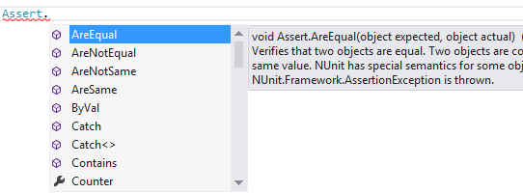
Assertions
Using Assertion we can compare for the controls property for
AreEqual
AreNotEqual
Contains
DoesNotMatch
EndsWith
IsNotNull
IsNull
Matches
StartsWith
Using the above comparator property we can compare for the controls using their compare value.

Slide 23
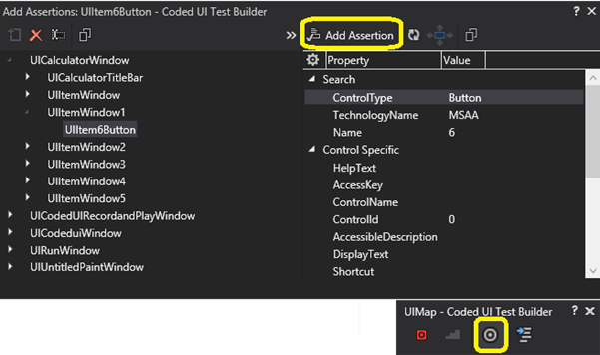
Assertions

Slide 24
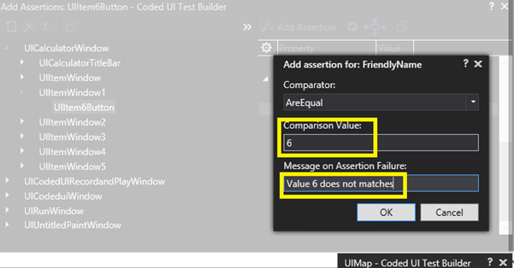
Assertions

Slide 25
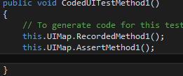
Assertions

Slide 26
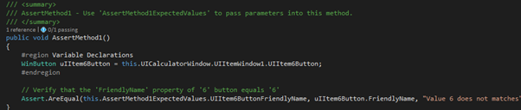
Assertions

Slide 27
How to locate an Element
By id
HTML: <div id="coolestWidgetEvah">...</div>
WebDriver:
driver.findElement( By.id("coolestWidgetEvah") );
By name
HTML: <input name="cheese" type="text"/>
WebDriver: driver.findElement( By.name("cheese") );
By Xpath
HTML
<html>
<input type="text" name="example" />
<input type="text" name="other" />
</html>
WebDriver: driver.findElements( By.xpath("//input") );
There are plug-ins for firefox/chrome to automatically display the Xpath

Slide 28
Sample Code Selenium
package com.example.tests; import com.thoughtworks.selenium.*; import java.util.regex.Pattern; public class temp script extends SeleneseTestCase { public void setUp() throws Exception { setUp("http://localhost:8080/", "*iexplore"); } public void testTemp script() throws Exception { selenium.open("/BrewBizWeb/"); selenium.click("link=Start The BrewBiz Example"); selenium.waitForPageToLoad("30000"); selenium.type("name=id", "bert"); selenium.type("name=Password", "biz"); selenium.click("name=dologin"); selenium.waitForPageToLoad("30000"); } }

Slide 29
Demo Page
public static void main( String[] args )
{
// Create a new instance of the Firefox driver
WebDriver driver = new FirefoxDriver();
// (1) Go to a page
driver.get("http://www.google.com");
// (2) Locate an element
WebElement element = driver.findElement(By.name("q"));
// (3-1) Enter something to search for
element.sendKeys("Purdue Univeristy");
// (3-2) Now submit the form. WebDriver will find the form for us from the element
element.submit();
// (3-3) Wait up to 10 seconds for a condition
WebDriverWait waiting = new WebDriverWait(driver, 10);
waiting.until( ExpectedConditions.presenceOfElementLocated( By.id("pnnext") ) );
// (4) Check the title of the page
if( driver.getTitle().equals("purdue univeristy - Google Search") )
System.out.println("PASS");
else
System.err.println("FAIL");
//Close the browser
driver.quit();
}

Slide 30
END!

